Slide 1


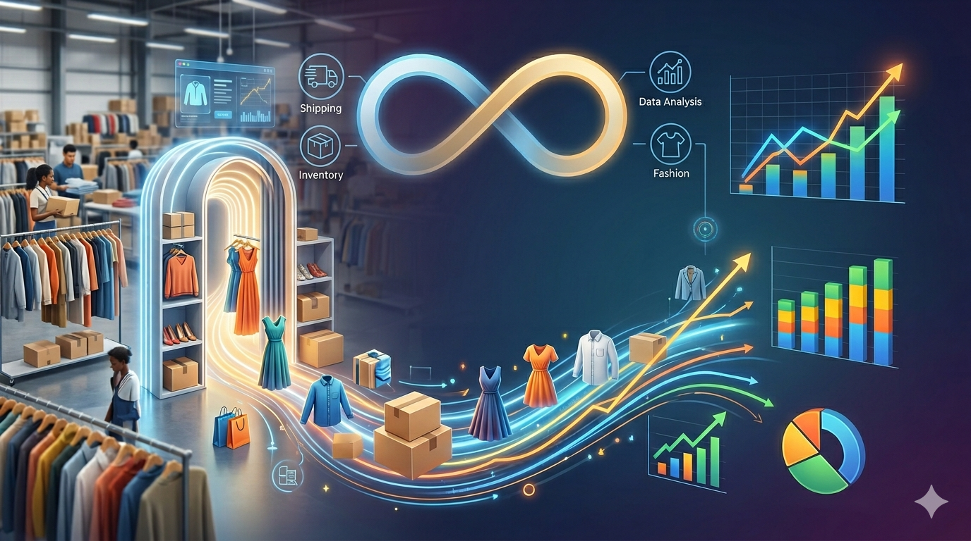
“THE
INFINITE
FITTING
ROOM”
A Strategic Audit of Reverse Logistic and Profit Recovery in E-commerce
Presented By:
Date:
Priyanka Kasera,
MBA
March 26,2026

Slide 2


PROBLEM STATEMENT
  Rise of “Infinite Fitting Room” Behaviour
  Returns = Hidden Costs(reverse logistics, quality inspections & restocking labor)
  Lack of Cost Visibility
  Silent Revenue Leakage
  Negative Net Margins

Slide 3

OBJECTIVE
Organize Data → Actionable Plan
Identify Drivers of the Returns
Uncover Hidden Costs and its Impact on Profitability
Reduce Avoidable Returns
Protect Profit Margins

Slide 4
WHO CAN USE THIS MODEL
Brand & category managers
Logistic & operations leads
Financial controllers
E-commerce strategist
Companies & startups

Slide 5




PROJECT SCOPE AND SCALE
Size:
2176 rows and 18 columns
Timeline:
2024-2026
Source:
Kaggle
Scope:
14 dimensions covering product specs, pricing and logistics

Slide 6
BRAND PERFORMANCE
Analyzed:
Formula: ROI = (Net Profit / Total Investment) × 100%
Zara recieved highest No. of Orders
H&M is the most Profitable Brand
Zara has the Best Customer Ratings
GAP offers higher avg Markdown% compared to other Brands

Slide 7

CATEGORY INSIGHTS
Accessories are the most ordered category
Shoes are the most returned category
Large Size and White Colour is the highest Return Product Spec

Slide 8
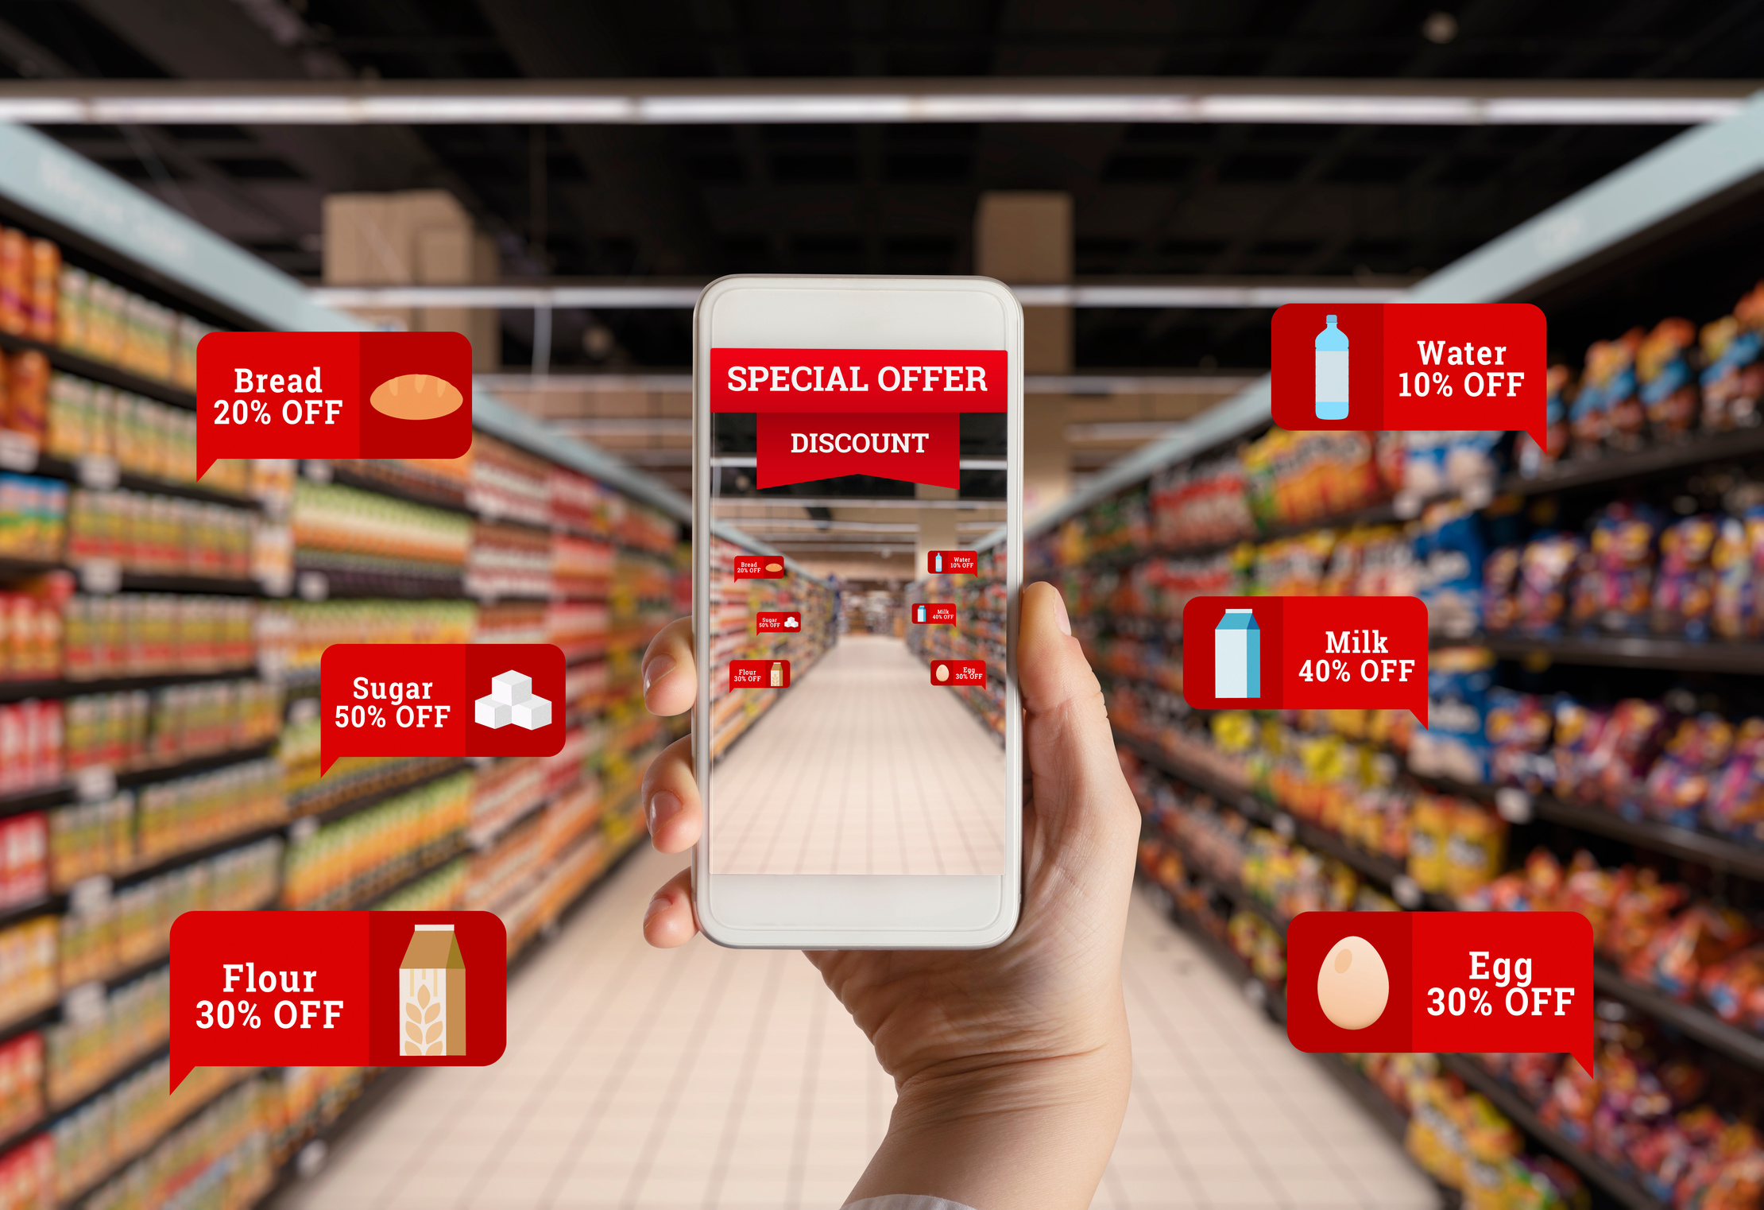
DISCOUNTINSIGHTS
Highest Avg Markdown% is observed in the summer season
Higher Discount does not mean drive More Orders:
PGAPDR - 16.21% - 28 and
PZARBO - 12.58% - 69

Slide 9
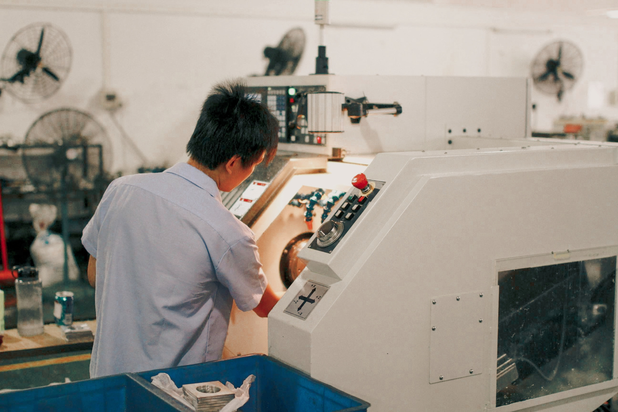
FUTURE ENHANCEMENTS
Recommendations:
A/B Testing On Markdown Levels
Recommendations:
Regular Quality Checks
Focus on High-returned segments
Detailed/Compare Size Chart and Fabric Feel Info
Styling tips
Return Fees, Drop-off Option

Slide 10

THANK YOU
Presented By:
Date:
Priyanka Kasera
March 25,2026

